Slide 1

Summarizing Privacy Policy with NLP
Simplifying legal documents for better
informed consent
Daniel Dimond
12/2/2024

Slide 2
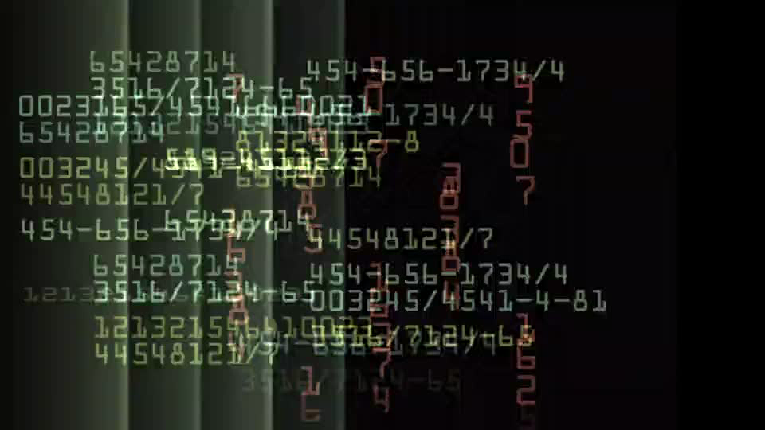
Introduction
Privacy policies are often too complex and lengthy for users to read, leading to uninformed consent.
Goal: Develop an NLP model to summarize privacy policy texts into concise, readable summaries.

Slide 3

Objectives
Summarize privacy policies with:
High abstraction
Effective compression
Semantic accuracy
Balance computational efficiency with readability and linguistic precision.

Slide 4
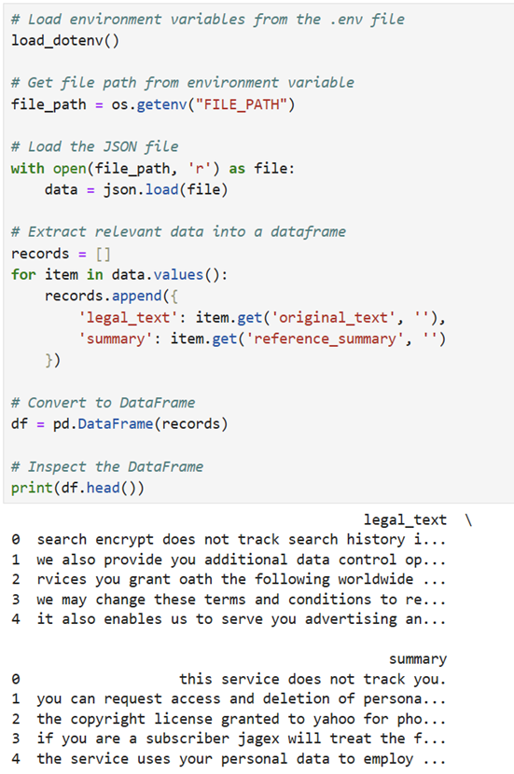
Dataset
Source: 421 pairs of legal texts and plain English summaries.
Characteristics:
Heavy abstraction and simplification.
Dataset verified manually for quality.

Slide 5
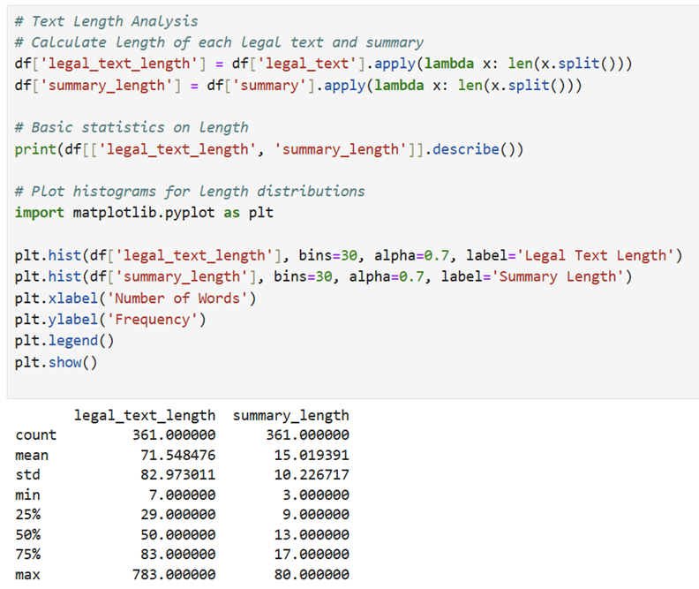
Methodology
Data Preprocessing:
Organized data in a structured DataFrame.
Cleaned irregularities in text while avoiding over-cleaning.
Conducted Exploratory Data Analysis (EDA):
Summary length ratios.
Pattern identification.
Data Splitting:
Divided data into training, validation, and testing subsets.

Slide 6
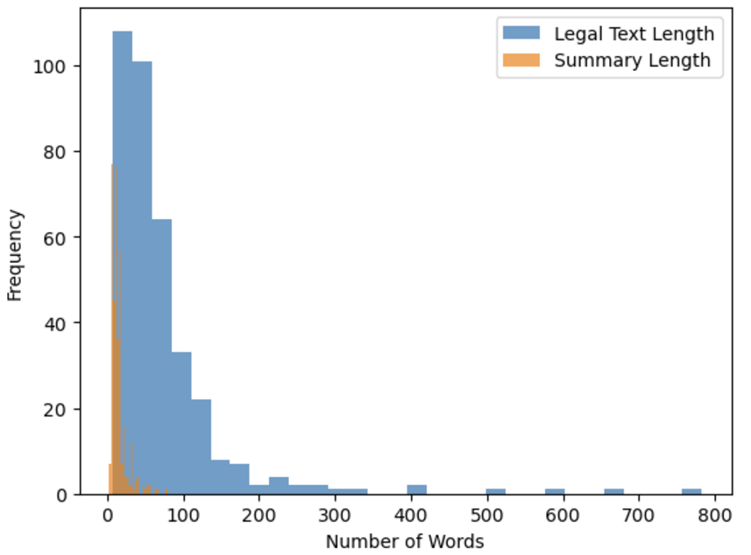
Modeling Approach
Model Used: Hugging Face's `facebook/bart-large-cnn`.
Tailored preprocessing for legal text summarization.

Slide 7
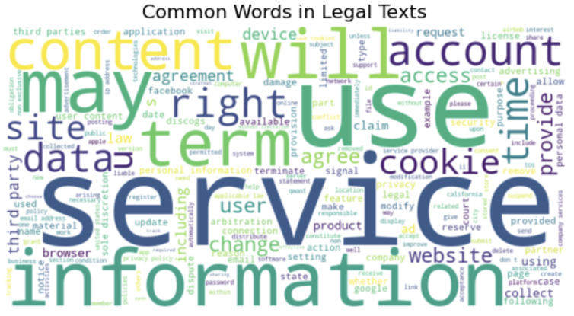
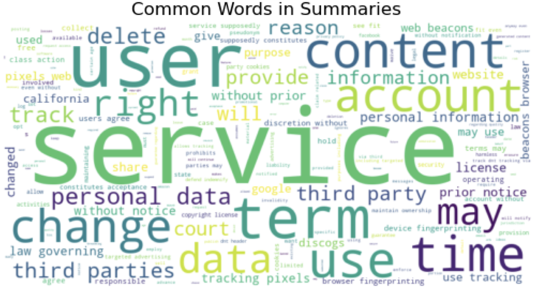
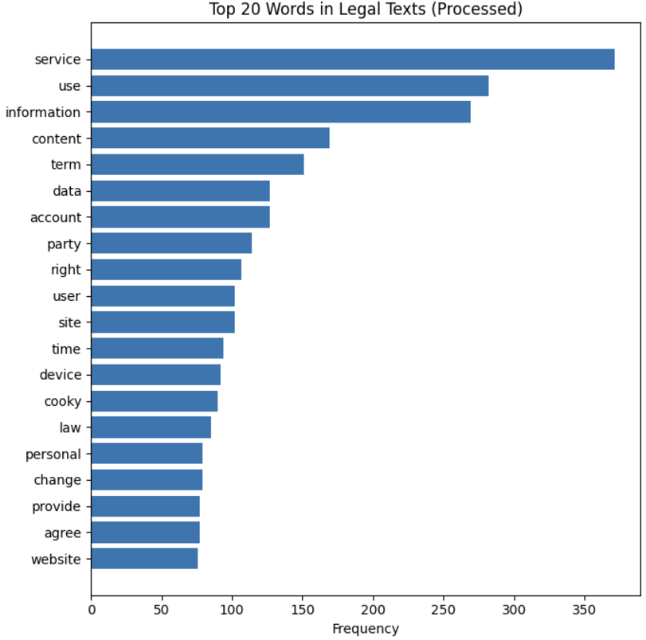
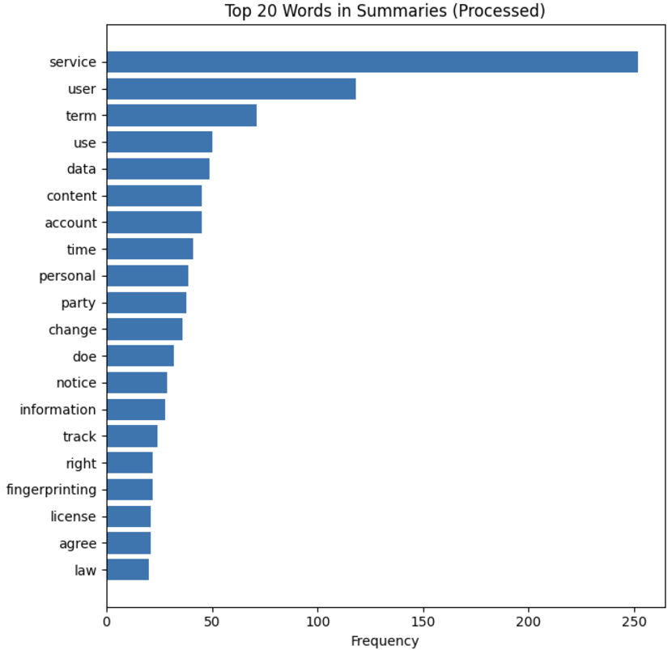
Common Words
Legal Text
Summaries

Slide 8
Evaluation Metrics
1. ROUGE: Measures n-gram overlap.
ROUGE Scores: 'rouge1': 0.2188,
'rouge2': 0.0702,
'rougeL': 0.1804,
'rougeLsum': 0.1799
2. BLEU: Evaluates precision in word matching.
Average BLEU Score: 3.30%
3. BERTScore: Leverages contextual embeddings for semantic similarity.
Precision: 0.8408
Recall: 0.8739
F1 Score: 0.8567

Slide 9
Observations and Insights
- Summaries significantly reduced word count while retaining meaning.
- ROUGE and BLEU were limited in assessing abstraction.
- Preferred Metric: BERTScore for semantic similarity.

Slide 10
Results and Conclusion
- Transformer-based architectures like BART are effective for abstractive summarization.
- Key Finding: Metrics that emphasize meaning and readability, like BERTScore, are crucial for this task.

Slide 11
References
https://github.com/maastrichtlawtech/awesome-legal-nlp
https://aclanthology.org/W19-2201/
https://github.com/lauramanor/legal_summarization/tree/master

